Slide 1
Is “Never Again” really possible?
Genocides after the Holocaust

Slide 2
The Politics of Labels
Ethnic Cleansing
Crimes Against Humanity
Genocide
Intent to permanently expel a group from a certain area.
No standalone legal implications.
Courts criminalize ethnic cleansing under crimes against humanity.
Can also be criminalized as persecution.
More immediate time frame.
A state can impose economic and military sanctions against another state.
Committed as part of a widespread or systematic attack on any civilian population.
Ethnic cleansing can fall under crimes against humanity.
No obligation to provide civil remedies, prevent or punish.
Less specific than genocide.
Can fall under the jurisdiction of a International Military Tribunal (IMT), but not under the jurisdiction of the International Court of Justice (ICJ).
Easier to prove intent than genocidal intent.
Intent to destroy an ethnic, national, racial, or religious group.
Considered a crime under international law.
Legal and political implications.
Obligates a country that signed the Convention to provide civil remedies, prevent and punish for the crime of genocide.
Can take decades to recognize as such.
Comes under the jurisdiction of the International Criminal Court (ICC).
Cannot fall under the jurisdiction of a IMT.

Slide 3
Questions to consider:
How many genocides took place under the cover of war or conflict?
Can you recall instances of cultural genocide?
Why do you think countries may be reluctant to label an act as genocide?
For those who commit genocide is there such a concept of “just” punishment?
Why do you think genocide keeps happening again?
What can the world do to prevent these acts?

Slide 4
What is a Genocide?
Coined in 1944 by Polish Lawyer Raphael Lemkin.
Acts committed with the intent to destroy, in whole or in part, a national, ethnical, racial or religious group.
Killing members of the group;
Causing serious bodily or mental harm;
Inflicting on a group conditions calculated to bring about its physical destruction;
Imposing measures to restrict or prevent births;
Forcibly transferring children of one group to another.

Slide 5
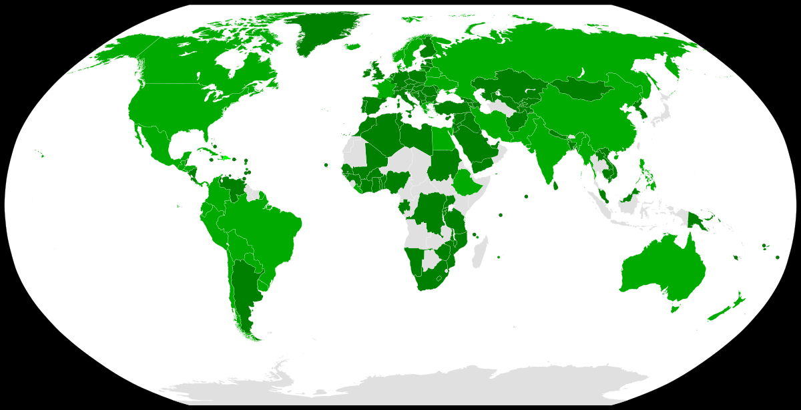
1948 Genocide Convention
Article I:
Nuremberg Trials (1945) :
Military Tribunals set up by the Allied Powers.
For the first time, those who perpetrated crimes against humanity were tried.
152 countries have signed the Convention on the Prevention and Punishment of the Crime of Genocide
“…genocide, whether committed in time of peace or in time of war, is a crime under international law which they undertake to prevent and to punish.”
Do you know: what year did the United States adopt the Genocide Convention?
Notes:
The U.S. did not fully adopt the Genocide Convention until November 8, 1988. Lawmakers were fearful of what the convention could mean for civil rights, superseding national sovereignty, and what implications it could have on U.S. actions in Vietnam.

Slide 6
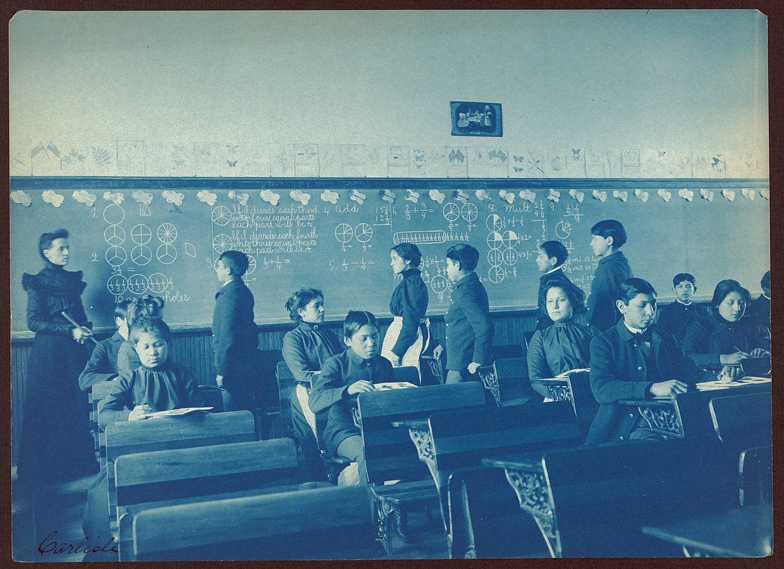
Cultural Genocide
Defined as “the destruction by brutal means of the specific characteristics of a group.”
Cultural genocide can include: forcibly moving children to another group; prohibiting of a group’s national language in written and spoken forms; destruction of religious works, or historical or religious monuments; and destruction or dispersion of objects or historical, artistic or religious value.
The act of cultural genocide is NOT included in the Genocide Convention.
Lemkin argued that the “destruction of the diversity of cultures is as disastrous as the physical destructions of nations.”
Native Americans at the Carlisle School in Pennsylvania.

Slide 7
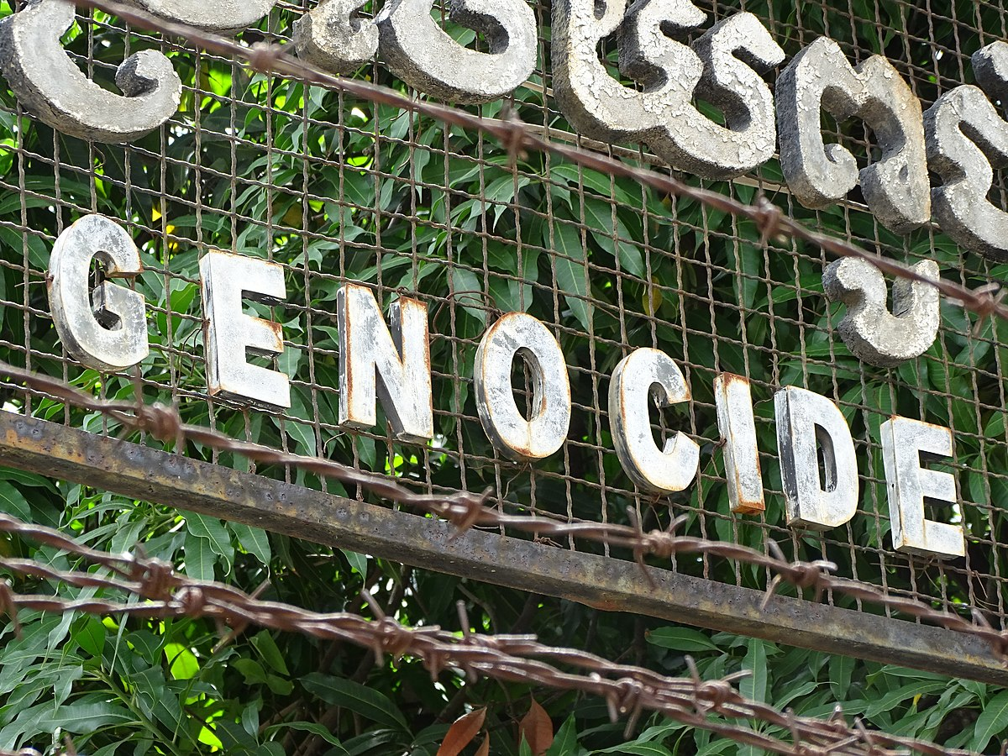
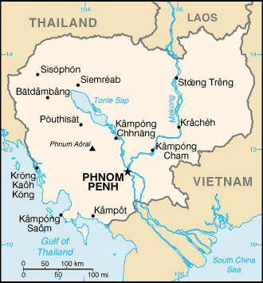
Genocides that resulted in International Trials:
Cambodia
Led by Pol Pot and the Khmer Rouge.
Believed that Cambodia citizens had been tainted by outside ideas.
Persecuted the elite first, then targeted upper and middle classes.
“Re-education” camps where thousands were sent. Those who refused were murdered in killing fields.
Murdered 1.5 - 2 million people from April 1975 – January 1979.

Slide 8
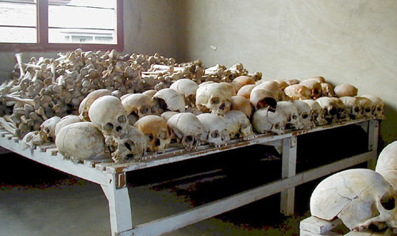
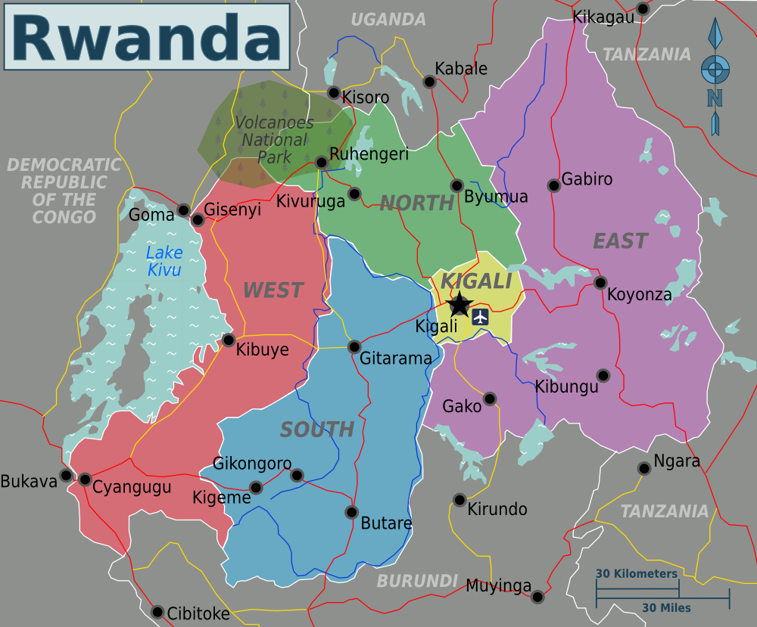
Genocides after 1945 continued:
Rwanda
Assassination of Rwandan President started the genocidal killings as his death was blamed on Tutsi rebels.
Tutsi minority were targeted by Hutu majority.
Rape was weaponized, with upwards of 500,000 women raped over 100 days.
In 100 days in 1994, 800,000 to 1 million Tutsi, moderate Hutu, and Twa were murdered.
The U.N. had soldiers stationed in the country but did not have the proper mandate to stop the genocide.

Slide 9
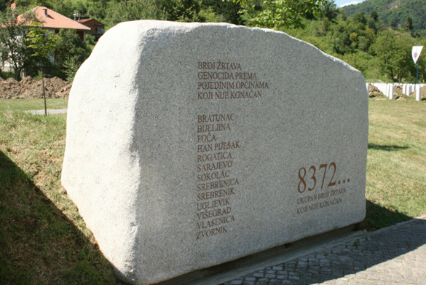
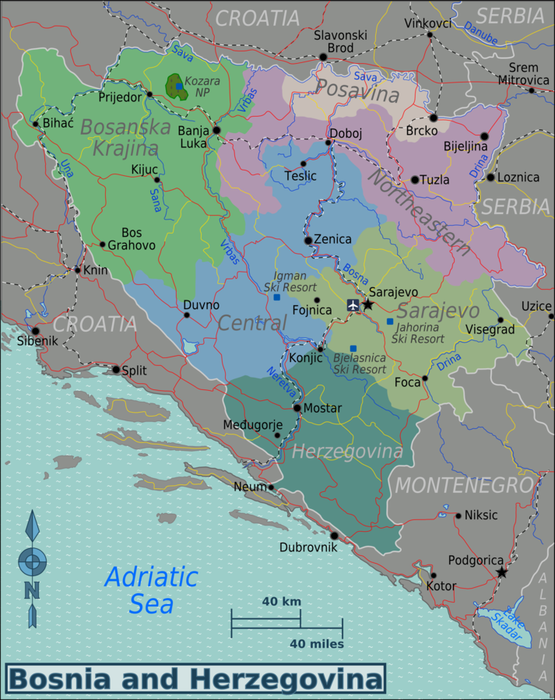
Genocides after 1945 Continued:
Bosnia
Committed by General Ratko Mladic and the Army of the Republika Srpska (VRS) in 1995.
Conflict between the Yugoslav Army and the Army of the Republic of Bosnia and Herzegovina.
In the town of Srebrenica, more than 8,000 Bosnian Muslims men and boys (Bosniaks) were murdered.
Nearly 30,000 Bosniak civilians were removed in a mass expulsion.

Slide 10
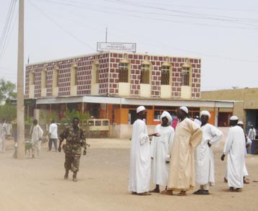
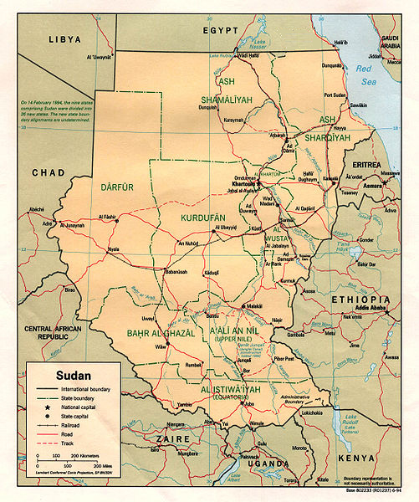
Genocides after 1945 Continued:
Darfur
Committed by the Sudanese government and Janjaweed beginning in 2003.
Ongoing conflicts and civil war in Sudan’s Western Darfur Region.
Darfur’s non-Arab population targeted by African-Arab population.
400,000 have been murdered. 10,000 women raped (number is disputed, could be double).

Slide 11
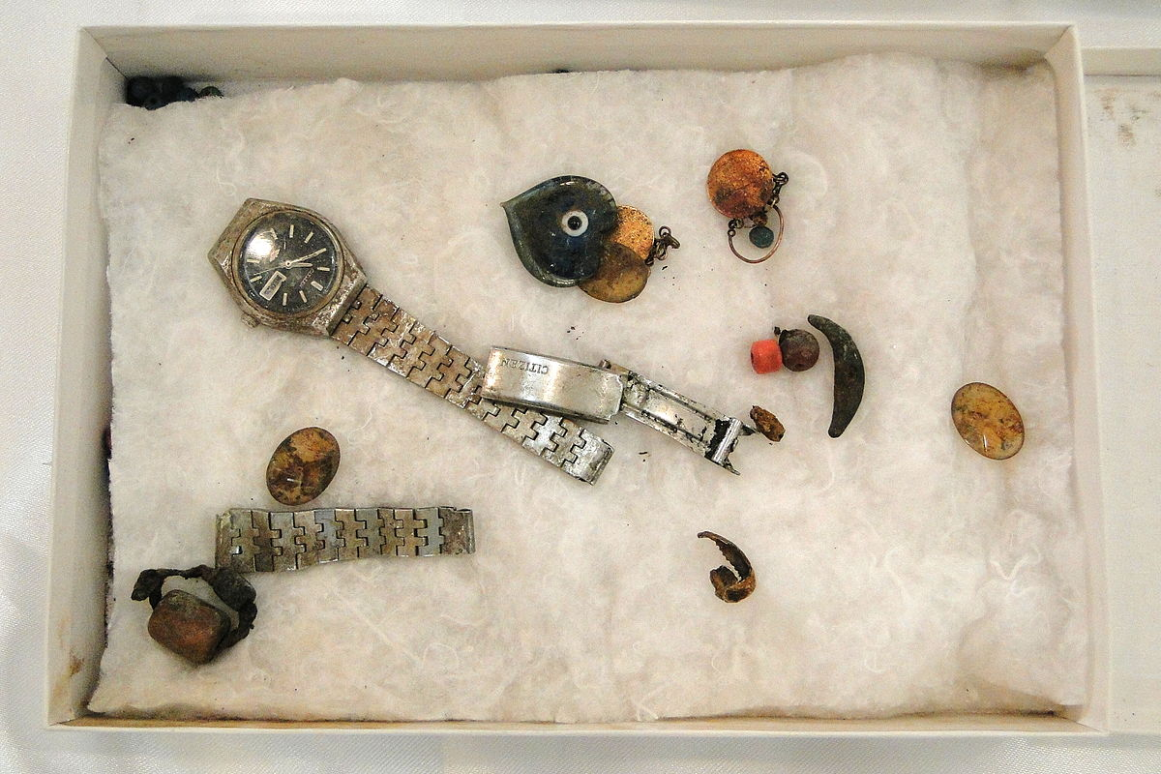
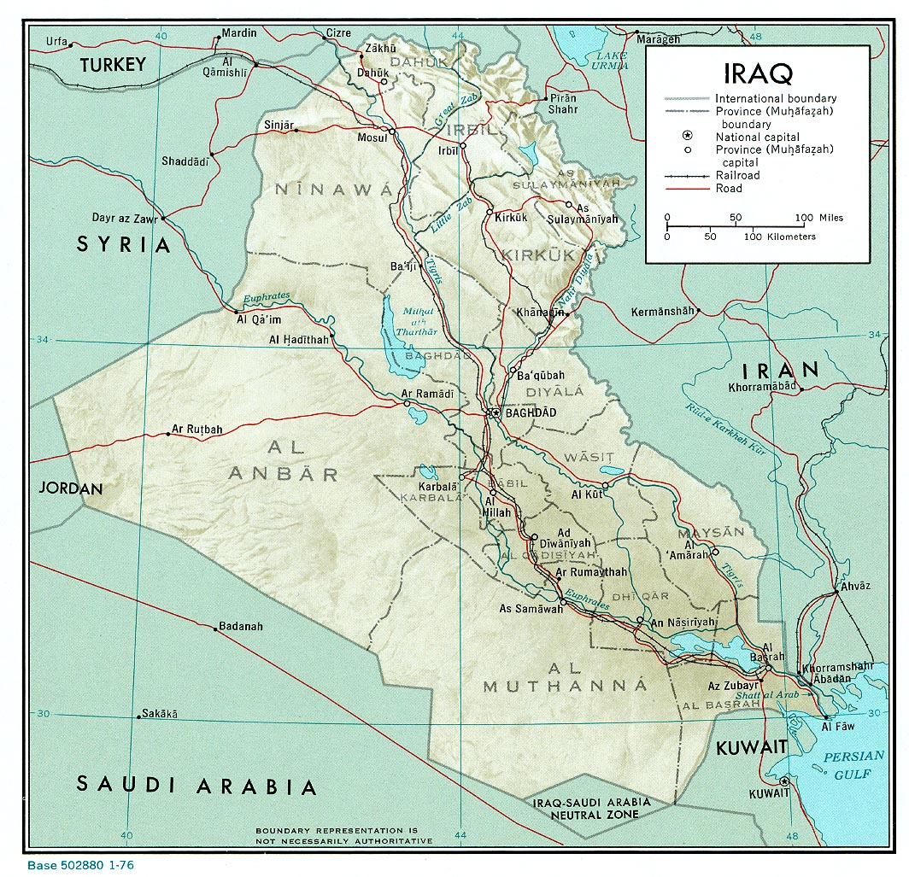
Genocides that did not result in International Trials:
Anfal Genocide:
Perpetrated by Saddam Hussein, Ali Hassan al-Majid and the Iraqi Government from 1986 to 1989.
Took place during the Iraq-Iran War.
Iraqi Kurds and Assyrian Christians were targeted by the Iraqi government and Kurdish collaborators.
Use of chemical weapons including mustard gas and sarin gas were used on the civilian population.
Nearly 180,000 were murdered.

Slide 12
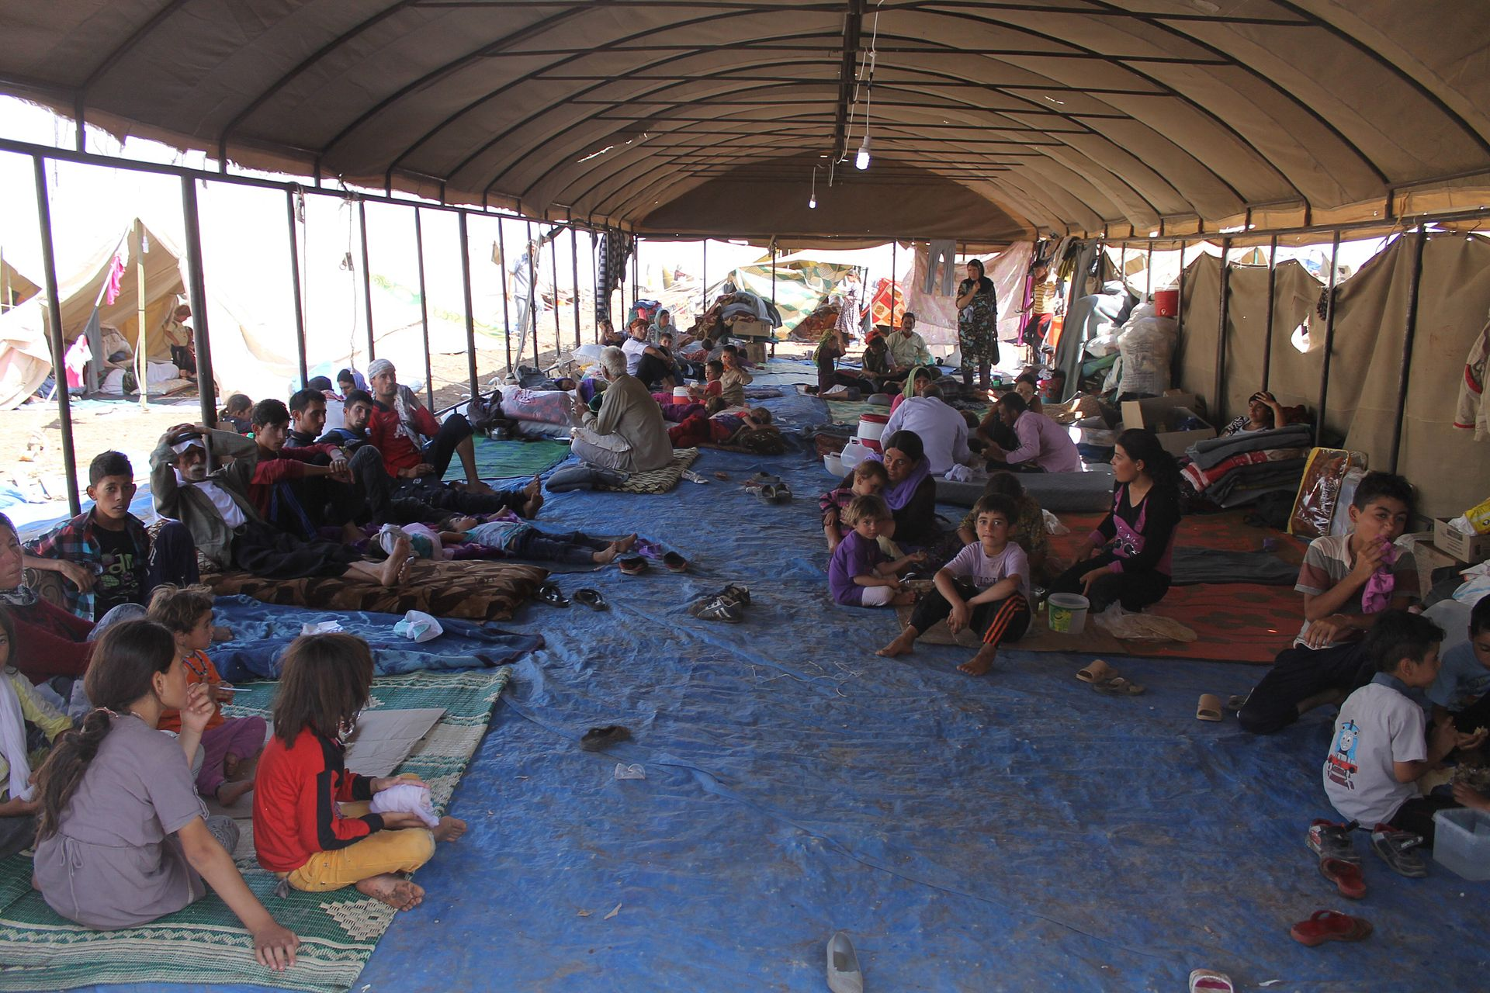
Genocides that did not result in International Trials continued:
Yazidis Genocide
Yazidis targeted by the Islamic State of Iraq and the Levant beginning in late 2014.
An estimated 7,000 women and girls were sold into sexual slavery while young boys were forced into ISIS training camps. Men and older women were killed.
At least 5,000 have been murdered, while thousands remain missing.
Mass graves have been identified.

Slide 13
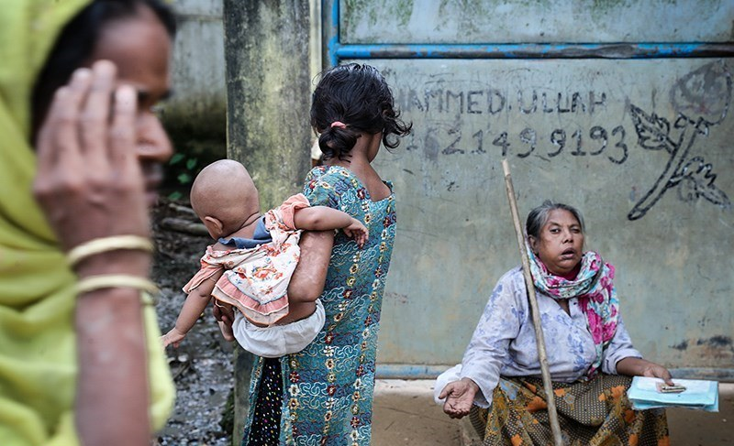
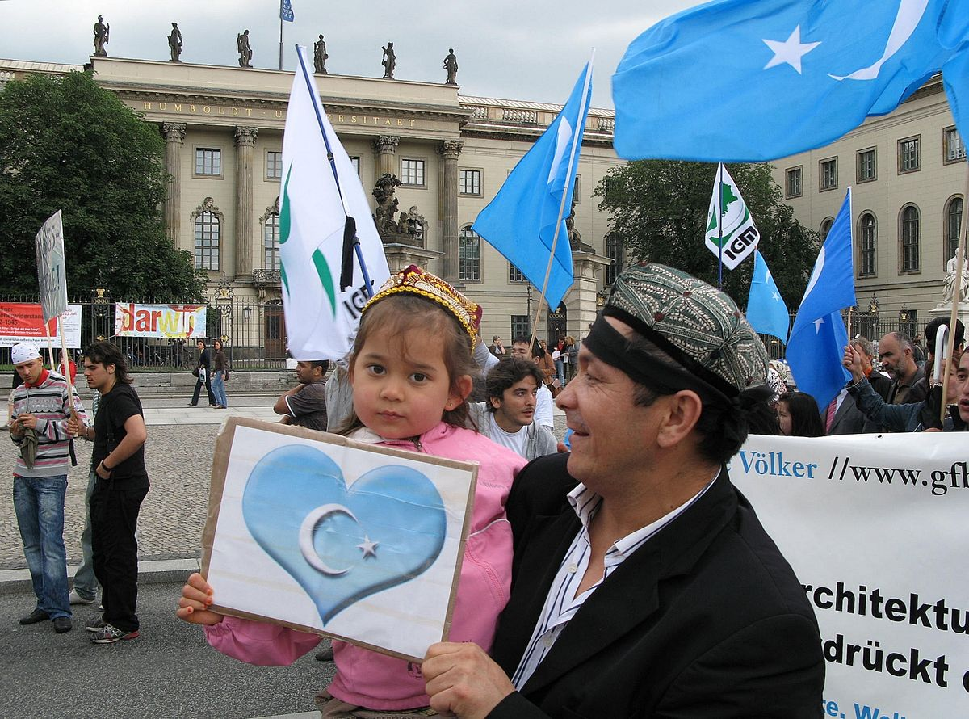
Ongoing situations
Myanmar
China
Rohingya Muslims
The murder of thousands of Rohingya Muslims at the hands of the Myanmar government is currently under investigation by the International Criminal Court (ICC).
Uyghur Muslims
An estimated one million Uighur Muslims in “re-education camps” designed to strip them of their religion and replace it with loyalty to the Chinese state.

